Slide 1

Smart Room Activity Monitoring and Behavior Analysis
using ESP32 and Machine Learning
Minor Project Report | April 2026
Hariom Yadav (23U02083) | Sardul V Pandey (23U02092)
Under the supervision of Dr. Priyankar Choudhary
Department of Computer Science and Engineering
Indian Institute of Information Technology, Bhopal

Slide 2
01
Introduction
CONTENTS
02
Literature Review
An overview of the project presentation covering introduction, literature, methodology, results, and conclusion.
03
Methodology
04
Results & Analysis
05
Conclusion & Future Scope

Slide 3
01
Introduction
Background, motivation, problem statement, objectives, and system overview

Slide 4
INTRODUCTION | LITERATURE | METHODOLOGY | RESULTS | CONCLUSION
Background & Motivation
Background
Key Focus Areas
• IoT enables real-time smart monitoring in homes and healthcare
• Cameras raise privacy concerns; wearables need user cooperation
• Sensor-based systems using ESP32 are simple and non-invasive
• Multiple sensors capture motion, light, temperature, humidity, distance
IoT Integration
ESP32 connects sensors to cloud via WiFi for continuous data collection
Real-Time Dataset
Data stored in Google Sheets with timestamps for realistic analysis
Machine Learning
Random Forest model classifies activities from sensor patterns
Behavior Analysis
Graphs reveal daily routines, sleep patterns, and activity trends
Motivation
• Need for low-cost, real-time, privacy-friendly monitoring
• Existing solutions use expensive hardware or controlled environments
• Pre-collected datasets often fail to match real-world conditions
• Goal: bridge hardware and intelligent data analysis with real-time data
• Convert raw sensor data into meaningful insights and behavior patterns
04

Slide 5
INTRODUCTION | LITERATURE | METHODOLOGY | RESULTS | CONCLUSION
Problem Statement & Objectives
The Problem
Activity | Description
Bed | Person lying or resting on bed
Chair | Person sitting on chair or table
Kitchen | Person present near kitchen area
Outside | Person not present in room
• Accurate activity identification from noisy real-world sensor data
• Fixed thresholds fail for varying human behavior and conditions
• Motion alone cannot distinguish sitting, resting, or slow movement
• Need for continuous, independent data collection without a laptop
• Challenge: integrate hardware and software simply and reliably
Objectives
• Design a sensor-based system for real-time data collection using ESP32
• Connect ESP32 to WiFi and transmit data to Google Sheets cloud platform
• Create a structured dataset with timestamps from actual sensor readings
• Preprocess data and train a machine learning model for activity classification
• Classify activities: Bed, Chair, Kitchen, and Outside
• Analyze behavior patterns using time-based graphs and visualizations
05

Slide 6
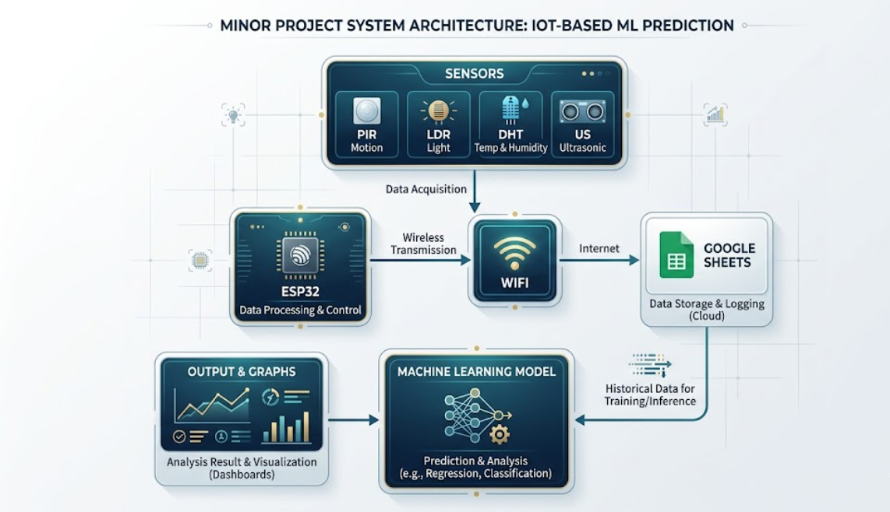
INTRODUCTION | LITERATURE | METHODOLOGY | RESULTS | CONCLUSION
Proposed System Overview
Three Main Components:
• Sensor Unit — PIR, LDR, DHT22, Ultrasonic
• Processing Unit — ESP32 with built-in WiFi
• Cloud & ML Unit — Google Sheets + Python
Workflow:
Sensors → ESP32 → WiFi → Google Sheets
→ Dataset → ML Model → Prediction → Graphs
What the System Detects
Bed
Low motion, stable distance, lights off
Chair
Moderate motion, varying distance
Kitchen
Specific time + activity pattern
Outside
No sensor activity in room
06

Slide 7
02
Literature Review
Evolution from rule-based systems to IoT and ML integration

Slide 8
INTRODUCTION | LITERATURE | METHODOLOGY | RESULTS | CONCLUSION
Existing Approaches & Our Solution
Approach | How It Works | Strengths | Weaknesses
Rule-Based | Fixed conditions and thresholds | Simple to implement | Not reliable in real-world conditions
Single Sensor | Uses one sensor type only | Low cost, easy setup | Limited information, poor differentiation
Multi-Sensor | Combines multiple sensors | More environmental information | Still relies on simple logic
Machine Learning | Learns patterns from data | Handles complex inputs, improves over time | Needs quality training data
IoT Real-Time | Continuous cloud-based collection | Cost-effective, automatic storage | Depends on network stability
Our Approach: The Best of All Worlds
• Combines multiple sensors (PIR, LDR, DHT22, Ultrasonic) for rich environmental data
• Uses machine learning (Random Forest) to learn patterns instead of fixed rules
• Leverages IoT (ESP32 + WiFi + Google Sheets) for real-time, automatic data collection
• Result: a system that is accurate, low-cost, privacy-friendly, and practical
08

Slide 9
03
Methodology
Hardware, software, data flow, and machine learning implementation

Slide 10
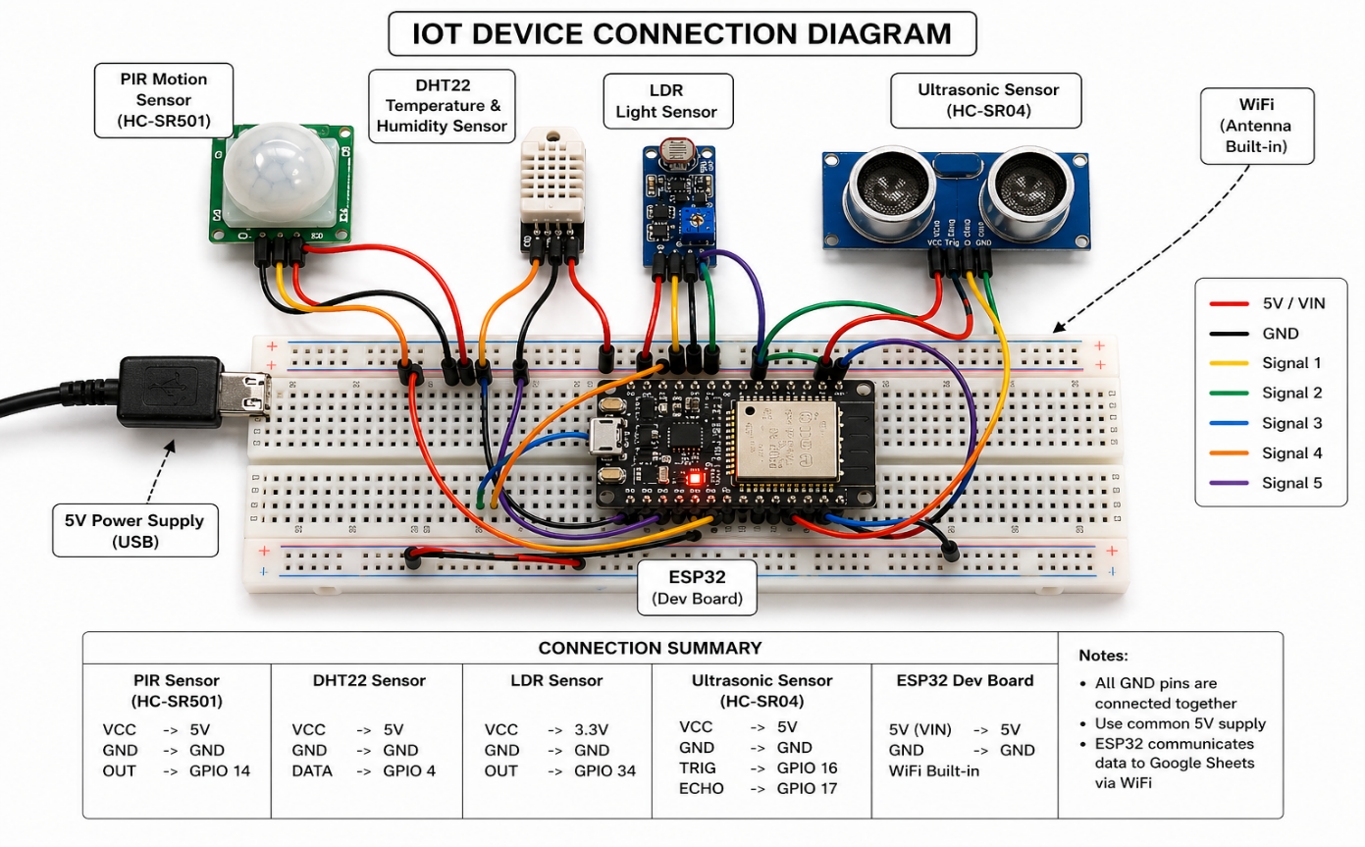
INTRODUCTION | LITERATURE | METHODOLOGY | RESULTS | CONCLUSION
Hardware Components
ESP32 Microcontroller
Central controller with built-in WiFi. Reads all sensors, processes data, sends to cloud. Operates at 3.3V.
PIR Sensor (HC-SR501)
Detects human motion. Range: 3-7m, Angle: 120°, Digital output (0/1).
LDR Sensor
Measures light intensity. Analog output 0-4095. Light ON ~960-975, OFF ~1065-1089.
DHT22 Sensor
Temp: -40°C to 80°C (±0.5°C). Humidity: 0-100% (±2-5%).
Ultrasonic HC-SR04
Distance: 2-400cm (practical: 20-300cm). Accuracy: ±3mm. Key for bed/chair/outside detection.
Power & Connectivity
USB power bank makes the system portable and independent.
10

Slide 11
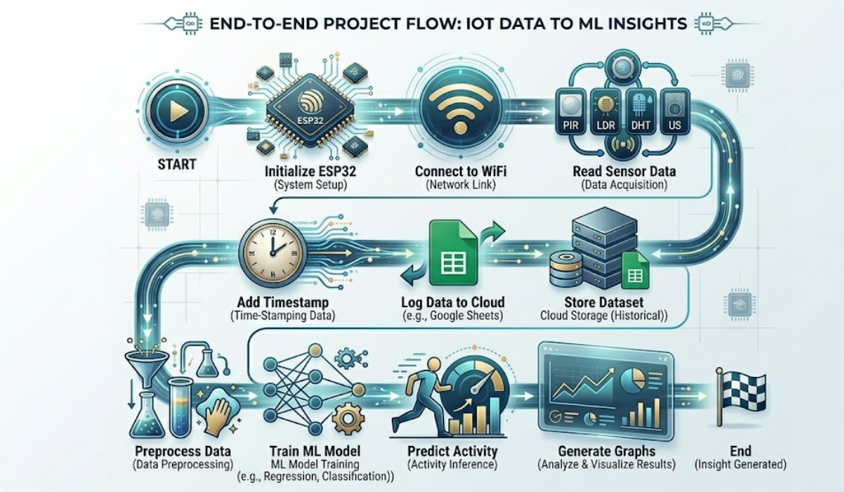
INTRODUCTION | LITERATURE | METHODOLOGY | RESULTS | CONCLUSION
Software Tools & Data Flow
Software Stack
Arduino IDE
ESP32 programming: sensor reading, WiFi, HTTP requests
Google Sheets
Cloud database with automatic row insertion via Apps Script
Python + Libraries
Pandas (data), Scikit-learn (ML), Matplotlib (graphs)
End-to-End Workflow
Sensors
Read Data
ESP32
Process + WiFi
Google Sheets
Store Data
ML Model
Random Forest
Prediction
+ Graphs
11

Slide 12
INTRODUCTION | LITERATURE | METHODOLOGY | RESULTS | CONCLUSION
Data Collection & Processing
Real-Time Data Collection
Dataset Structure
• Sensors read values at regular intervals automatically
• Each entry includes: Time, Motion, Light, Temperature, Humidity, Distance
• ESP32 sends data to Google Sheets via HTTP using WiFi
• Google Apps Script API adds rows automatically — no manual entry
• Power bank makes the system portable for long-term collection
Field | Type | Source
Time | Timestamp | ESP32 RTC
Motion | Digital (0/1) | PIR Sensor
Light | Analog (0-4095) | LDR Sensor
Temperature | Celsius | DHT22
Humidity | Percentage | DHT22
Distance | Centimeters | Ultrasonic
Hour | Feature (0-23) | Derived
Data Preprocessing
• Remove missing or incorrect sensor values
• Convert timestamps into useful features: hour and day
• Organize data into structured format for ML training
• Normalize values if required for model stability
• Label data based on observed activities: Bed, Chair, Kitchen, Outside
All data is collected in real-world conditions, making the dataset more realistic than pre-existing datasets used in many research projects.
12

Slide 13
INTRODUCTION | LITERATURE | METHODOLOGY | RESULTS | CONCLUSION
Machine Learning Model
Model: Random Forest Classifier
Activity Classification Logic
• Chosen for its strength with multiple input features
• Handles complex, non-linear relationships well
• Provides good accuracy for classification problems
• Dataset split into training and testing sets
• Model learns patterns from 6 input features
• Trained model saved for future predictions
Bed
Low motion + stable short distance + lights off + nighttime
Chair
Moderate motion + varying distance + lights on + any time
Kitchen
Meal-time patterns + motion + moderate distance
Outside
No motion + large distance + no light changes
Combining all six features improves reliability and allows better differentiation between similar activities.
Input Features (6)
• Motion — PIR sensor digital output
• Light Intensity — LDR analog reading
• Temperature — DHT22 Celsius value
• Humidity — DHT22 percentage
• Distance — Ultrasonic cm measurement
• Hour — Time feature from timestamp
13

Slide 14
04
Results & Analysis
Environmental data, activity patterns, and machine learning performance

Slide 15
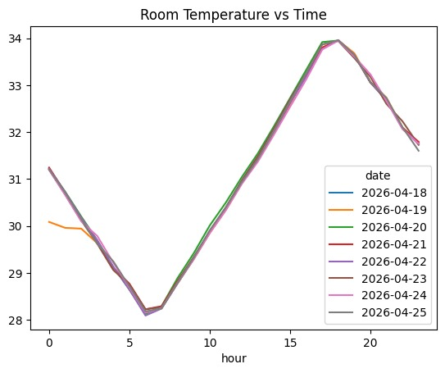
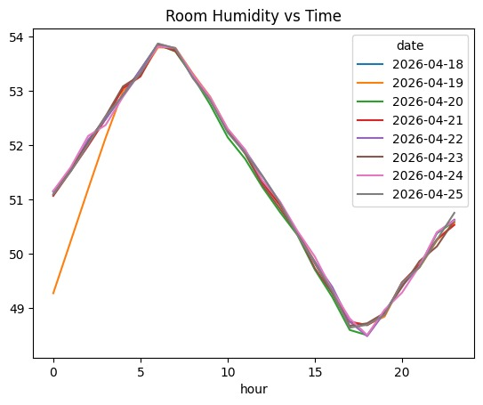
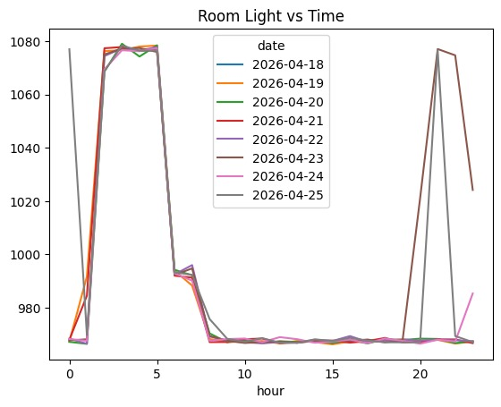
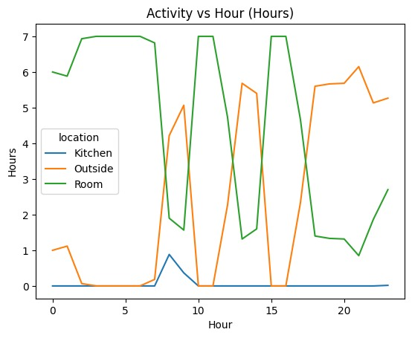
INTRODUCTION | LITERATURE | METHODOLOGY | RESULTS | CONCLUSION
Environmental & Activity Analysis
Room Environment
• Temperature: Lowest 28-29°C early morning, peaks 33-34°C evening — follows natural daily cycle
• Humidity: Inverse trend, 53-54% morning to 48-49% evening — confirms real-world conditions
• Light: Sharp ON/OFF transitions help identify active vs sleeping periods
Activity Distribution
• Room: Maximum time spent here, high presence at night and early morning
• Kitchen: Limited usage, mostly during morning or meal times
• Outside: Increases during day and evening, minimal at night
• Activity distribution matches a realistic daily routine
• System successfully captures natural human behavior patterns
15

Slide 16
INTRODUCTION | LITERATURE | METHODOLOGY | RESULTS | CONCLUSION
ML Performance & Key Observations
Model Accuracy
Activities Classified
Input Features
76-79%
4
6
Random Forest Classifier
Bed, Chair, Kitchen, Outside
Motion, Light, Temp, Humidity, Distance, Hour
Key Observations
Limitations
• Temperature and humidity follow natural daily patterns
• Light intensity clearly indicates active and inactive periods
• Distance and motion are the most important features
• System captures realistic human behavior over multiple days
• Activity distribution graphs match expected daily routines
• Sensor noise can occasionally affect readings
• Similar activities (bed vs chair) may sometimes overlap
• Accuracy depends on quality and quantity of training data
• Real-time delay may affect detection of fast motion
• Scope limited to controlled indoor environment
Final Result: The system successfully integrates IoT and machine learning for real-time activity monitoring with accurate prediction and meaningful visualization — meeting all project objectives.
16

Slide 17
INTRODUCTION | LITERATURE | METHODOLOGY | RESULTS | CONCLUSION
Conclusion & Future Scope
Conclusion
Future Scope
• Successfully developed a complete IoT + ML monitoring system
• ESP32 collects real-time data from all sensors continuously
• Data transmitted to Google Sheets via WiFi without a laptop
• Random Forest achieved 76-79% accuracy classifying 4 activities
• Graphical analysis revealed daily behavior and environmental trends
• Project demonstrates practical hardware-software-ML integration
• Add advanced sensors: gas, sound, or camera for higher accuracy
• Use deep learning models with larger datasets to reduce errors
• Develop a mobile or web app for real-time data and predictions
• Extend to smart home automation and elderly health monitoring
• Add real-time alerts for unusual activity or emergencies
• Scale to larger environments and multiple rooms
Real-World Applications
Smart Homes
Automated lighting, climate control, and security
Elderly Care
Health monitoring and fall detection alerts
Security
Anomaly detection and surveillance systems
Real-Time Alerts
Emergency notifications for unusual behavior
17

Slide 18
THANK YOU
Smart Room Activity Monitoring and Behavior Analysis
using ESP32 and Machine Learning
Hariom Yadav (23U02083) | Sardul V Pandey (23U02092)
Supervised by Dr. Priyankar Choudhary
Department of Computer Science and Engineering
Indian Institute of Information Technology, Bhopal
Questions & Discussion

